Slide 1

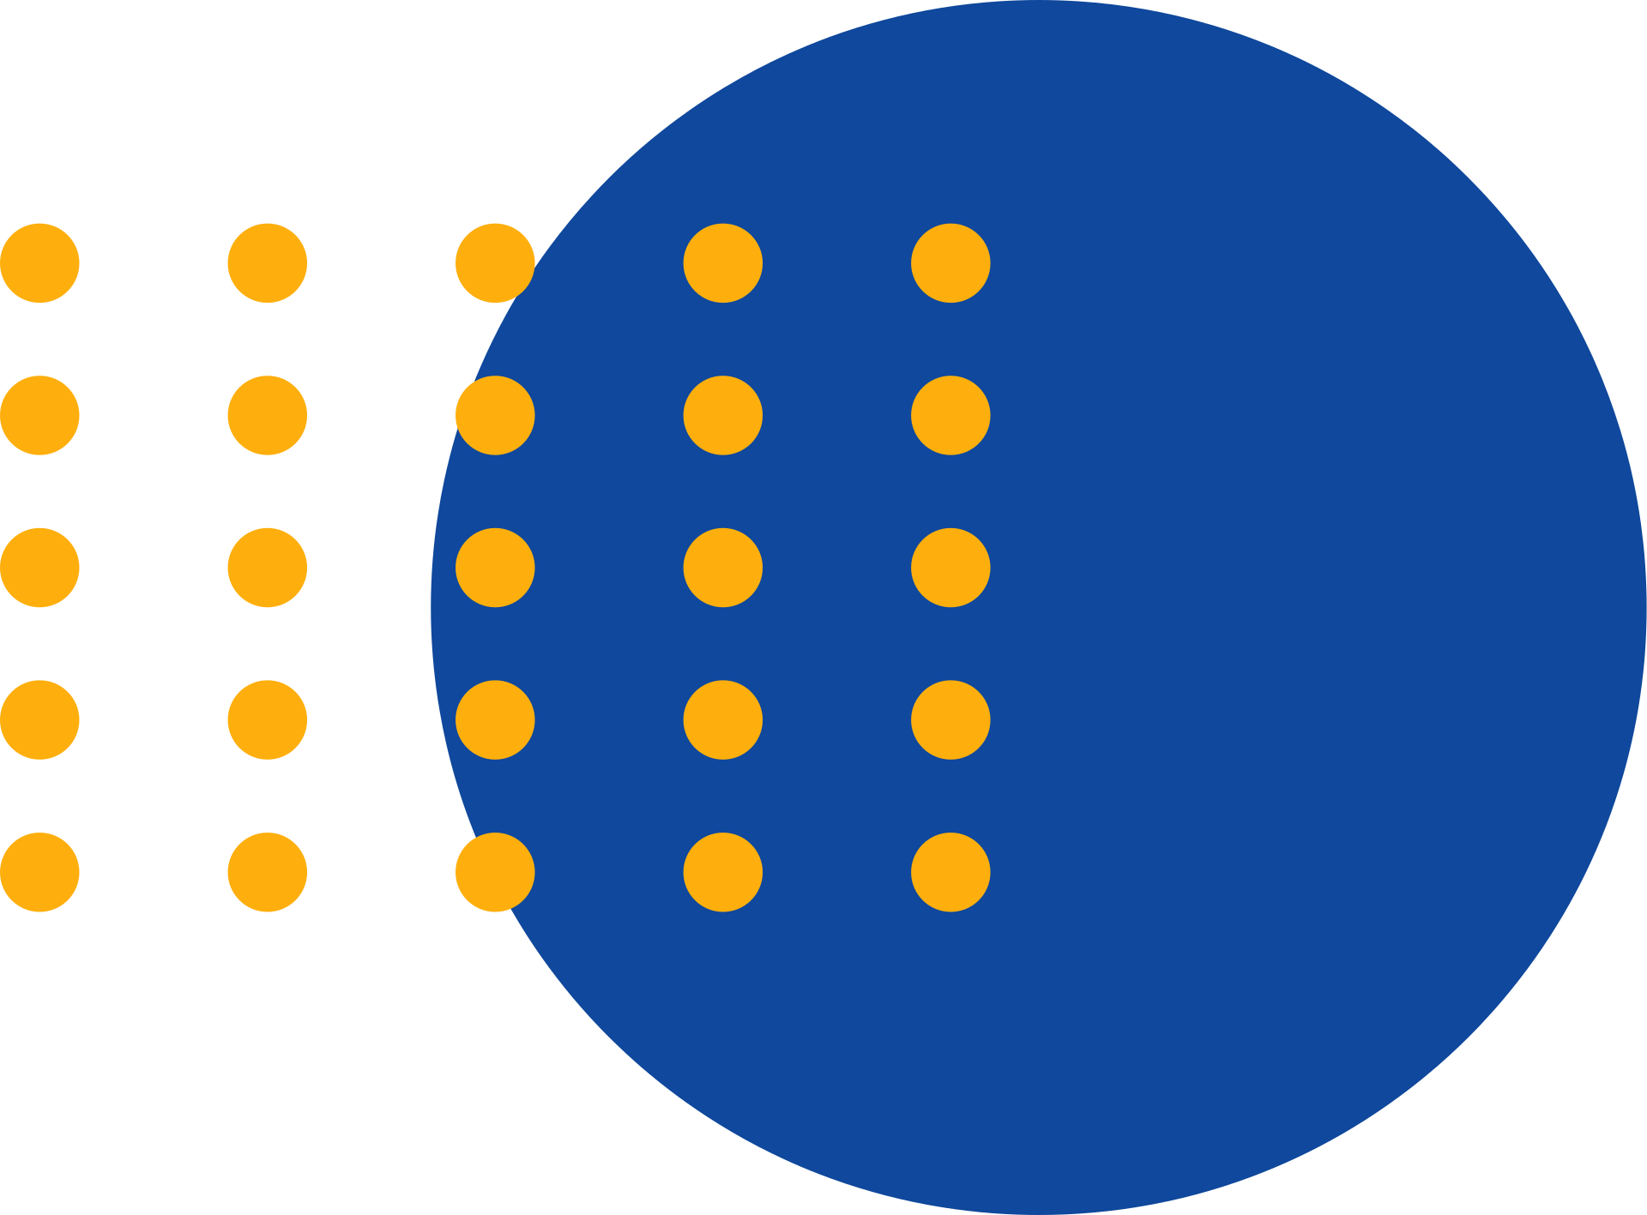


Tech-Talk
By Muhammad Arbaz Hussain

Slide 2


What is Andromeda?
It’s The Latest Update of Meta
We might not see it on your dashboard
We might not even know it’s live yet
Meta just quietly changed everything about how ads work.
Let’s talk about Andromeda, and why it means creative > targeting.

Slide 3
Targeting is Dead, The Machine Decides.
Forget stacking interests or obsessing over audiences.
Meta’s new AI, Andromeda, handles bidding, placements, and targeting automatically.
Your job now is to stop guessing whom to target and start perfecting what to show them.

Slide 4
Creative = Targeting Now.
Every headline, image, and caption is a data signal.
Meta studies which creative resonates with which users, and delivers it accordingly. That means your creative is your audience.
Your story decides who sees it.
Your hook decides who stays.

Slide 5
The New Campaign Setup:
1 Campaign
1 Ad Set
10–20 Different Creatives
Broad Targeting
The simpler the structure, the better the system learns.

Slide 6
What’s Behind Andromeda?
It’s Meta’s new AI brain, powered by NVIDIA and Meta’s own superchips.
It can scan millions of ads per second to predict the best match for every user.
Manual targeting? Gone.
Human optimization? Outpaced.
AI matchmaking? That’s the new game.

Slide 7
What Should We Do?
Focus on creative diversification.
Don’t make 10 similar ads.
Make 10 different ones:
Different stories
Different pain points
Different tones
Different personas
Give Meta options. It’ll find who loves each one.

Slide 8
The Trade-Off:
We’ll lose some control, but we’ll gain speed and scale.
Andromeda rewards advertisers who create fast, bold, and different.
The winners aren’t the best media buyers anymore. They’re the ones who can out-create everyone else.

Slide 9
The New Meta Playbook:
Simplify campaigns
Go broad
Test 10–15 unique creatives
Refresh weekly
Track ROAS & CAC
Trust the AI

Slide 10
Final Takeaway:
Targeting is dead.
Creative is the new targeting.
Structure is the new strategy.
Andromeda isn’t the end of advertising.
It’s what advertising was always meant to be:
Great ideas, shown to the right people, at the right time.

Slide 11
Thank You

