Slide 1
Basics of Google Shopping Ads for eCommerce Brands

Slide 2
Agenda
• What Shopping Ads are & why they matter
• Merchant Center & Product Feed fundamentals
• Shopping campaign types
• Promotions in Merchant Center

Slide 3
What are Google Shopping Ads
Shopping Ads are visual product ads that appear on Google Search, the Shopping tab, YouTube, and Display Network when people search for products online.
Used for eCommerce businesses to promote their products.
What do Shopping Ads look like?
A Shopping Ad usually shows:
🖼️ Product image
🏷️ Product title
💰 Price
🏪 Store/brand name
⭐ Ratings or offers
Because users can see the product and price upfront, these ads attract high-intent buyers.

Slide 4
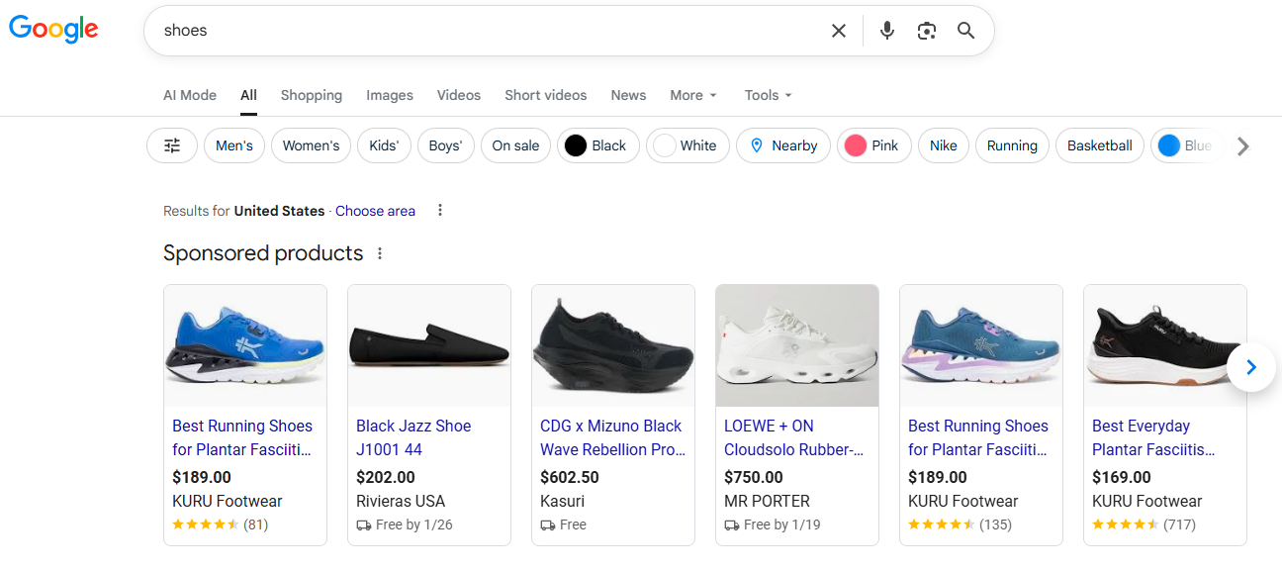
Shopping Ads on Google Search
Shopping ads appear at the top of Google Search results.
They help users compare products instantly by image, price and brand.

Slide 5
Why Google Shopping Ads Matter for eCommerce
Users see product and price before clicking
Traffic is more qualified compared to text ads
Better visibility for products
Strong driver of online sales
Better conversion rates
Automatic targeting with product feed

Slide 6
Merchant Center – The Foundation
Google Merchant Center (GMC) is a platform where eCommerce businesses upload and manage their product data so Google can show their products in Shopping Ads
Holds all product information in a product feed
Feed quality directly impacts visibility, CTR and performance.
Controls approvals, disapprovals & policy compliance.

Slide 7
Shopping Campaign Types
Standard Shopping – manual control
Performance Max – automation & scale
Demand Gen – awareness & discovery

Slide 8
Standard Shopping Campaign
Ads mainly appear on Google Search and Shopping Tab
Advertiser controls bids & structure
Best choice for learning and controlled growth
Triggered by user search intent.
Ideal for capturing high-intent shoppers.

Slide 9
Performance Max Shopping Campaign
Performance Max Shopping is an automated campaign that uses your product feed and Google AI to drive maximum sales across Search, Shopping, YouTube, Gmail, and Discover.
Uses machine learning to optimize results
Requires less manual management
Google’s AI automatically:
Chooses where ads appear
Selects which products to show
Decides bids, audiences, and creatives.

Slide 10
Performance Max – Feed Only
Uses only product feed
No images, videos or ad copy required
Focused primarily on Shopping placements
Google automatically creates ads using:
Product image
Product title
Price
Store name
Google’s AI decides:
Where to show the ad
Who to show it to
How much to bid

Slide 11
Demand Gen Shopping Campaign
Visual, discovery-based shopping ads
It does not behave like Shopping campaigns and does not appear in Search or the Shopping tab
Shown on YouTube and Discover feeds
Builds demand before active search
Create demand for products
Drive discovery, interest, and engagement.

Slide 12
Shopping Campaign Types
Campaign Type | Goal | Placements | Control | Best For
Standard Shopping | Direct sales | Search + Shopping Tab | Manual | Businesses starting with Shopping Ads
PMax Shopping | Direct sales | Search, Shopping, YouTube, Gmail, Discover, Display | Automated | Scaling eCommerce businesses
Demand Gen (with feed) | Awareness & consideration | YouTube, Gmail, Discover, Display | Automated | Businesses wanting to show products dynamically to generate interest

Slide 13
Promotions on Shopping Ads
Managed inside Merchant Center
Shopping promotions are created and managed in Google Merchant Center, and then automatically applied to eligible Shopping Ads.
Approved by Google before going live
Shopping Promotions appear on:
Google Search (Shopping results)
Shopping Tab
❌ Do not appear in Demand Gen campaigns.

Slide 14
Key Takeaways
Merchant Center is the backbone of Shopping ads
Feed quality drives visibility and performance
Different campaigns serve different business goals
Promotions enhance competitiveness and results

