Slide 1

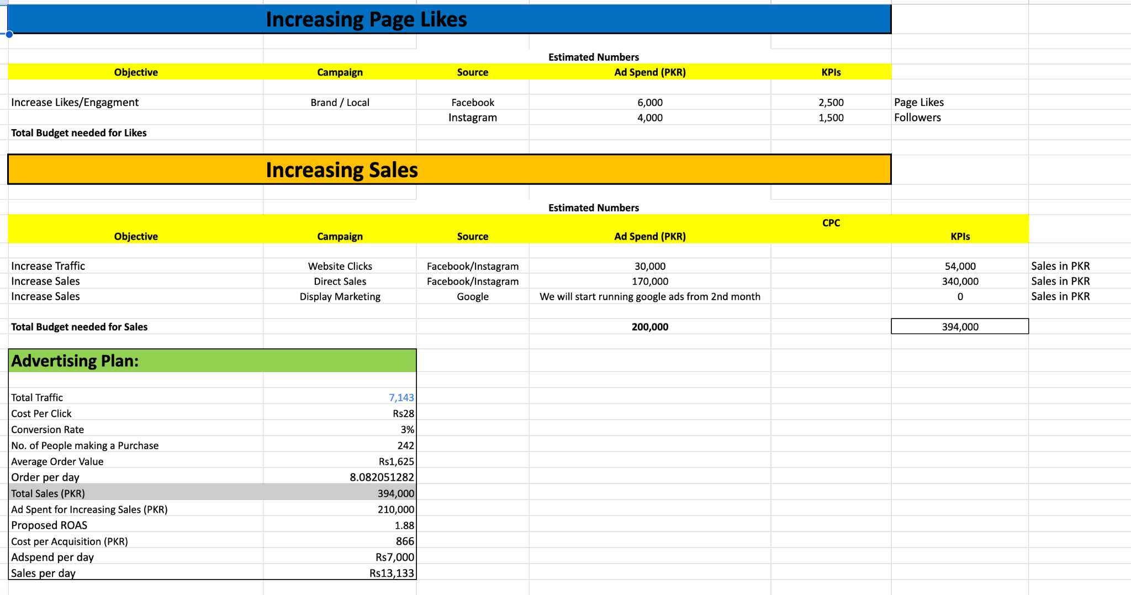
The Step Before Paid Marketing
A Plan That Will Make the Client Agree to Paid Marketing

Slide 2
The Problem
If you don’t create a breakeven plan, how will the client know how much to spend.
If there is no plan, how will we understand the required budget.
If a plan is not prepared, how will we know when the brand will reach breakeven.
Without a plan, how can we identify the right sources for marketing.
If the strategy is missing, it becomes difficult to track performance and ROI.

Slide 3
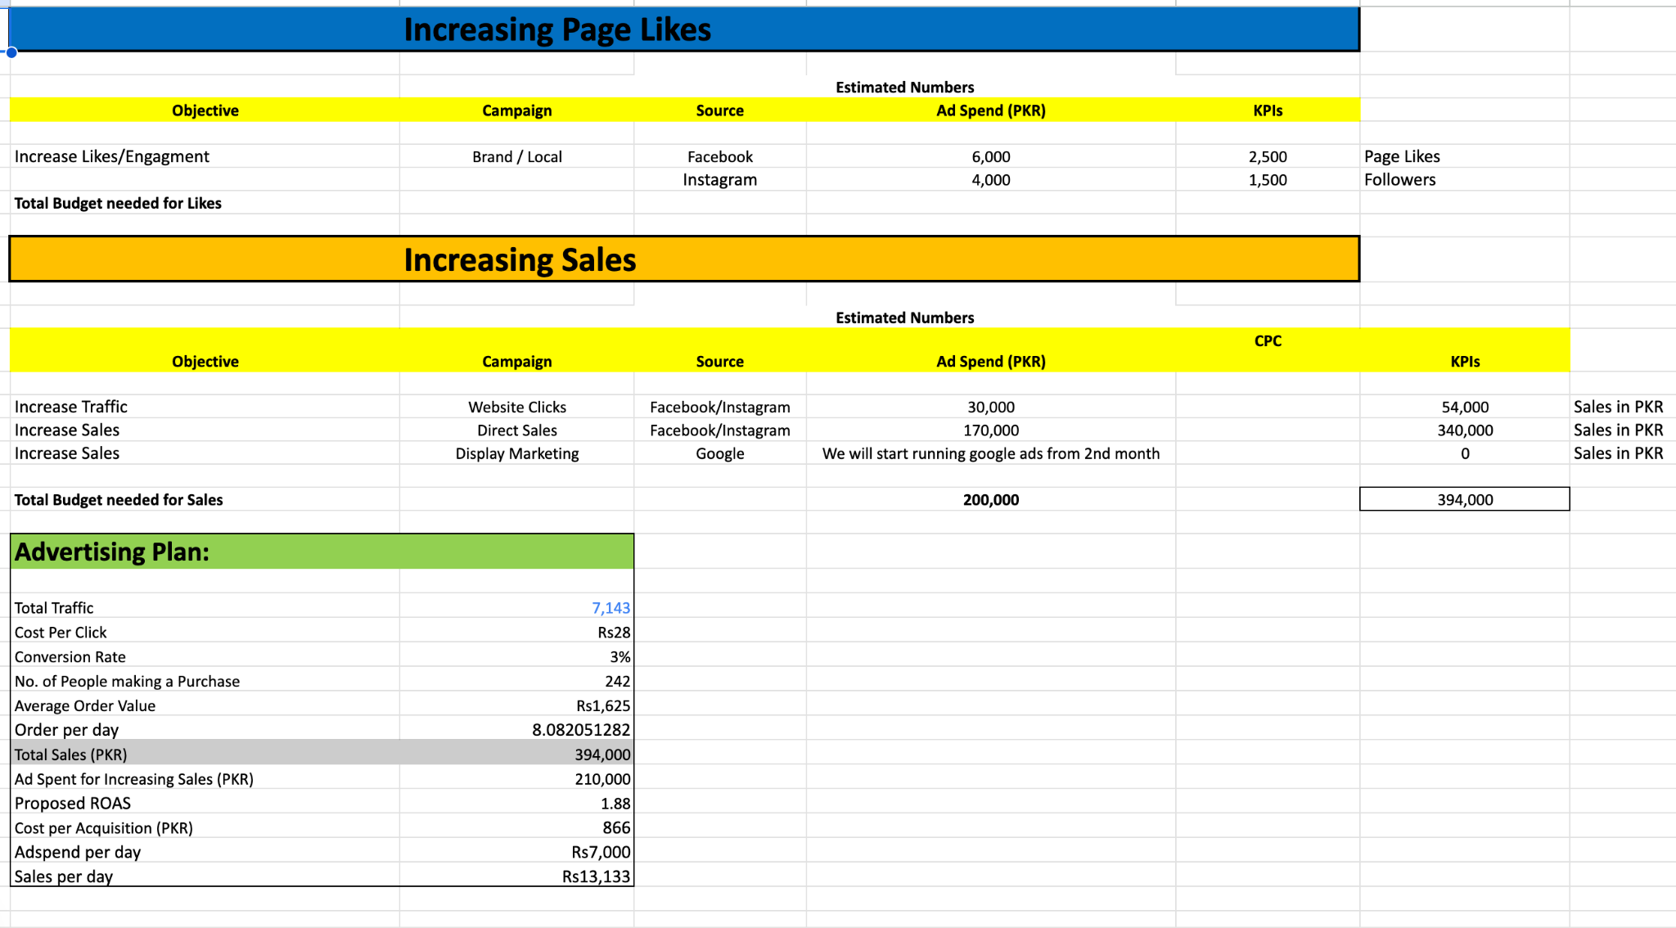
1st Month
Marketing Plan
1

Slide 4
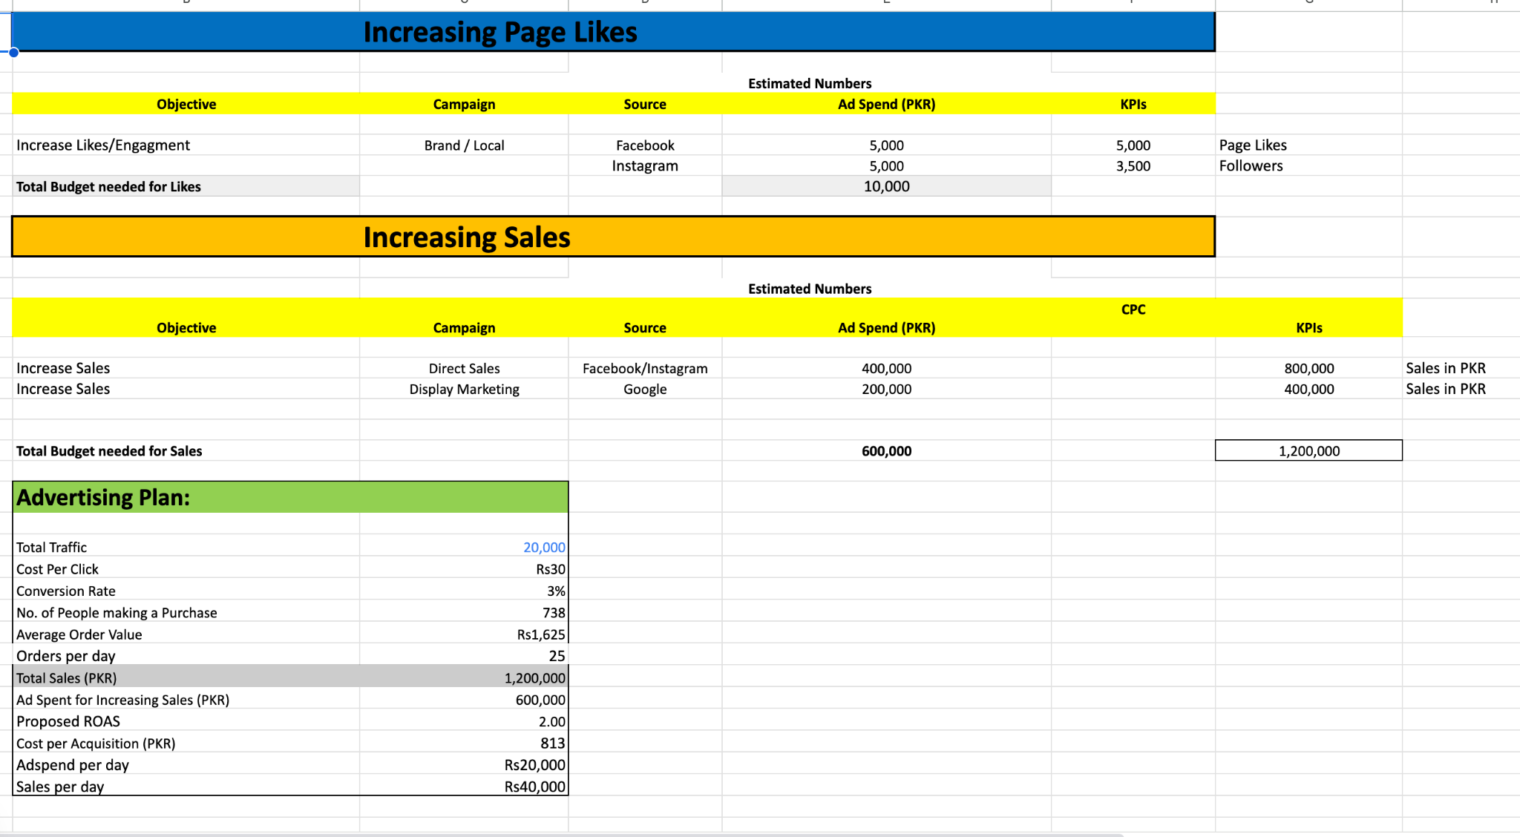
2nd Month
Marketing Plan
1

Slide 5
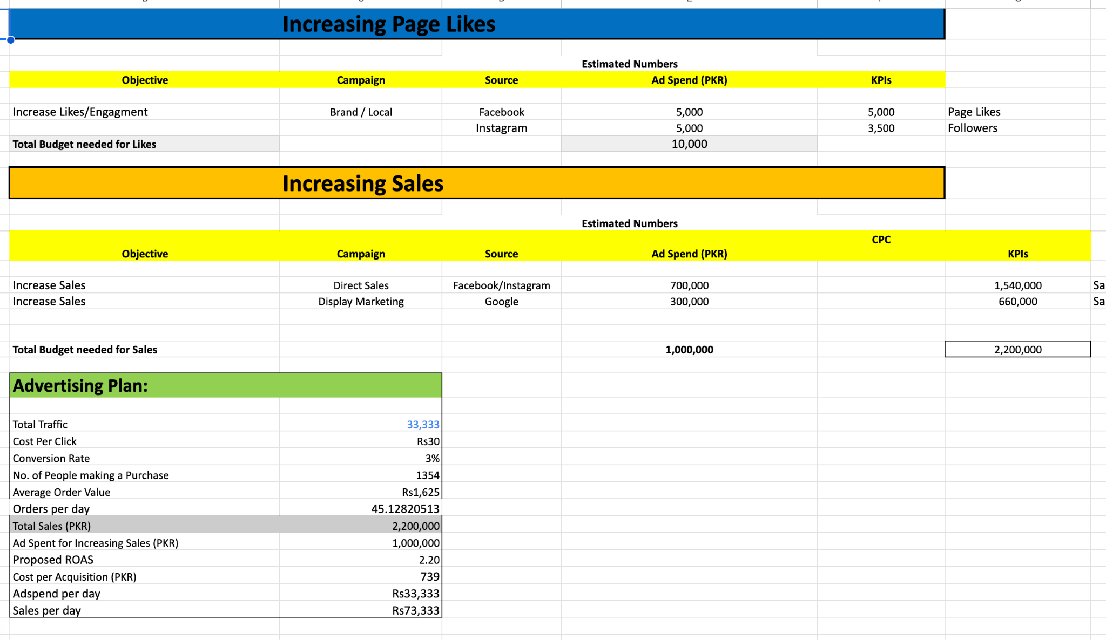
3rd Month
Marketing Plan
1

Slide 6
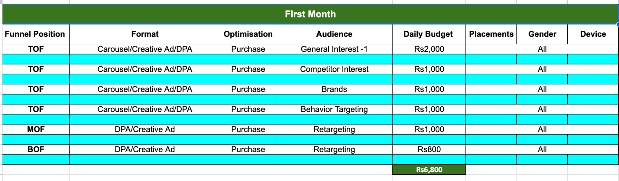
1st Month Campaigns Strategy
1

Slide 7
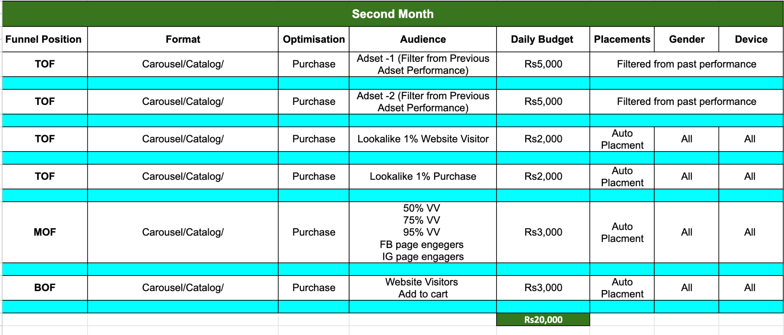
1st Month Campaigns Strategy
1

Slide 8
Case Study Link
https://docs.google.com/presentation/d/16zxHPJLHDxDoKtqAy39qMicQxZCDymcJxklZyrxc2Hk/edit?usp=sharing

Slide 9
Questions?

Slide 10
Thank You

