Slide 1

Off-Page Outreach & Relationship Building Techniques
PRESENTED TO
PRESENTED BY
adhamster Team
Shumail Ayub

Slide 2


Off-Page Outreach:
Actively contacting website owners or publishers to request backlinks or mentions by offering value.
Relationship Building:
Developing long-term connections with site owners and influencers to earn natural, ongoing links over time.
PRESENTED TO
PRESENTED BY
adHamster Team
Shumail Ayub

Slide 3

Key Points:
Backlinks are all that matter → Quality counts more.
More links don’t always mean a higher rank.
Social shares boost visibility, not rankings directly.
SEO is never one-time work; consistency matters.
PRESENTED TO
PRESENTED BY
adHamster Team
Shumail Ayub

Slide 4

Mostly Advised Off-Page Techniques
  Guest Blogging
  Forums
  Q&A Participation
  Blog Commenting
  Directory Submission
  Broken Links
  Brand Mentions
  Resource Pages
  HARO
  Interview/Podcasts
[adHamster - The Digital Refinery
PRESENTED BY
Shumail Ayub - SEO Expert

Slide 5

Mostly Applied Off-Page Techniques
  Guest Blogging - Paid
  Podcast & Webinar Collaborations
  Digital PR & Brand Mentions
  Content Syndication
  Niche Communities
  Visual Assets
  Influencer Partnerships / Influencer Outreach
  Partner Websites
  Publisher Outreach
  Link Exchange
  Resource Page Links
[adHamster - The Digital Refinery
PRESENTED BY
Shumail Ayub - SEO Expert

Slide 6
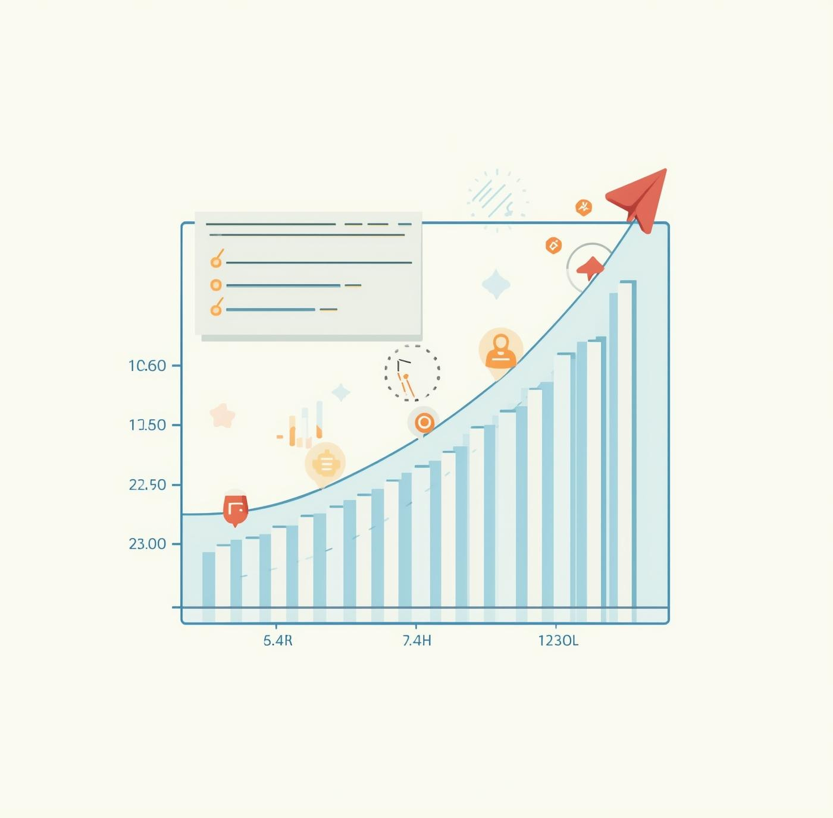
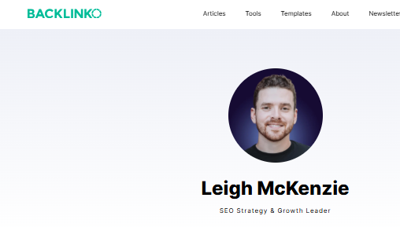
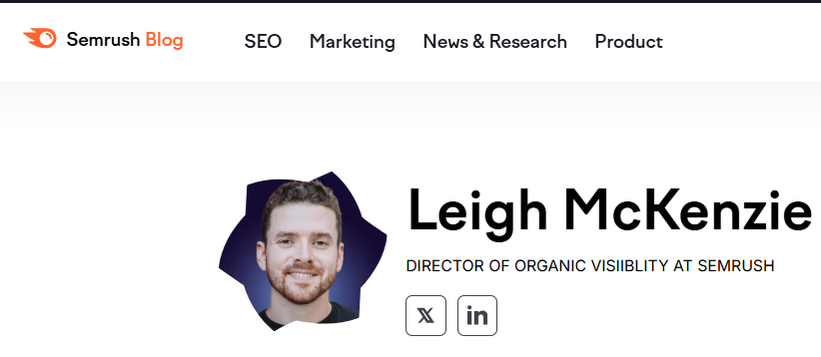
Partners or competitors

Slide 7
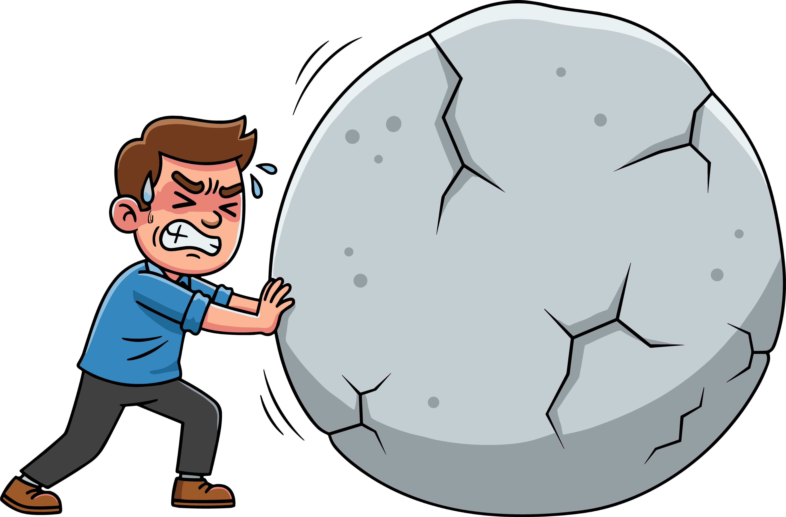
Key Challenges We Face
PLATFORM REACTIONS (VPN / IP USE)
  VPN detection
  IP reputation
  Trust reduction
  Rate limits
  Shadow bans
  CAPTCHA loops
  Access challenges
  Session limits
  Account throttling
  Multiple Login Issues

Slide 8
Key Challenges We Face
CLIENT OFF-PAGE RESTRICTIONS
  Outreach limits
  Link exchange ban
  No partnerships
  Brand risk
  Competitor fear
  Legal limits
  NDA constraints
  Organic only
  Client control

Slide 9
Key Challenges We Face
US OUTREACH CHALLENGES
  Slow responses
  Time-zone gaps
  Approval delays
  Limited access
  Trust issues
  Email filtering
  High standards
  Long negotiations

Slide 10
Strategies to Earn Backlinks Early
CONTENT LIMITATIONS
  Writer availbility
  Length Limitations
  Approval delays
  Topics Approval
  Trust issues
  Generic Output
  Accuracy Risk
  Expert Collaboration

Slide 11

Things We Try
  GUEST POSTING OUTREACH
  REVIEW SITE SUBMISSION
  FREE CITATIONS
  REDDIT LINK TRADE
  LINKEDIN OUTREACH
  BROKEN LINK REPLACEMENT

Slide 12
Strategies to Earn Backlinks Early
  Open for Link Trade
  Guest posting: Offer to write content for blogs in your niche.
  Build relationships: Connect with bloggers, communities, and forums.
  Use smaller niche sites: Easier to get backlinks, even with low DA.
  Leverage social media & communities: Share content where people notice and link naturally.

Slide 13



Social Media Engagement
CONNECT WITH INFLUENCERS ONLINE
Building strong relationships on social media is essential for reaching your target audience effectively.

Slide 14

Ineffective Backlink Techniques to Avoid
  Link farms
  Paid spam links
  PBN links
  Comment spam
  Forum spam
  Low-quality directories
  Irrelevant guest posts
  Exact-match anchor abuse
  Automated link building
  Bulk Reciprocal link schemes
RISKY METHODS CAN HARM YOUR REPUTATION
Always choose safe backlink strategies.

Slide 15
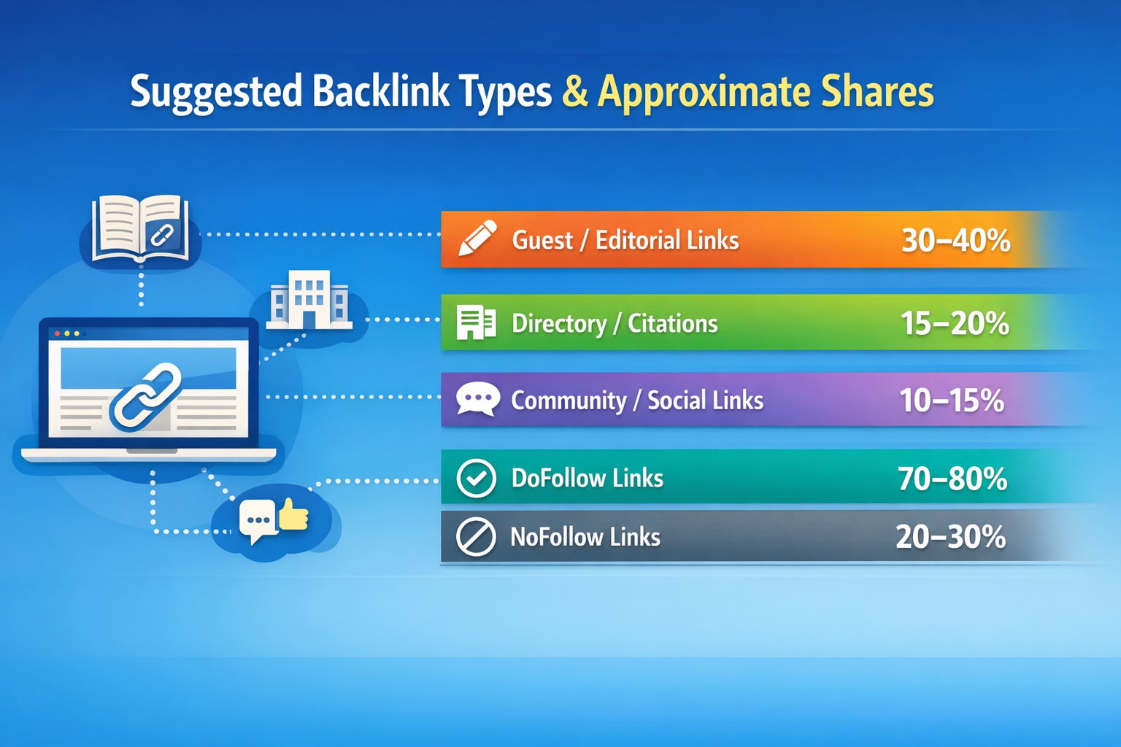

Slide 16

Thank You!

