Slide 1
Demand Gen: Understanding Google’s Vision.
Presented by Haider hussain.

Slide 2
Performance Max vs Demand Gen: Core Differences
Objective: PMax maximizes conversions with full automation; Demand Gen inspires consideration and action from pre‑intent audiences.
Inventory: PMax covers Search, Display, YouTube, Gmail, Maps; Demand Gen covers YouTube (incl. Shorts), Discover, Gmail.
Audience Targeting: PMax automated via signals; Demand Gen allows more manual control with lookalike, interest, and first‑party data.
Creative Type: PMax uses dynamic text/image; Demand Gen is visual‑first with image and video creatives.
Funnel Stage: PMax drives lower‑funnel conversions; Demand Gen engages mid‑to‑upper funnel users.
Sources: Google Ads Help; Seer Interactive; Blueprint Digital

Slide 3
When Does It Make Sense to Use Demand Gen?
Targeting users in awareness or consideration stages.
When prioritizing creative control and visual storytelling.
When quality of leads matters more than volume.
When leveraging YouTube, Discovery, and Gmail for engagement.
Goal: Inspire action before users start searching.
Source: Adsmurai Google Demand Generation Campaigns

Slide 4
Google’s Vision for Demand Gen
Bridges the gap between social discovery and search performance.
Designed for marketers competing in visual ecosystems like YouTube Shorts and Discover.
Uses AI‑powered audience expansion and creative testing for resonance.
Enables pre‑intent performance aligning awareness with measurable conversions.
Sources: Think with Google; Google Marketing Live 2024

Slide 5
Limitations
Attribution Complexity: Users may see your ad in Demand Gen, then search for your brand later. Determining which campaign “deserves” the conversion can be tricky
Creative-Dependent Performance: Success heavily relies on engaging visuals and messaging. Poor creative can lead to low CTR and engagement.
Reporting Granularity: You may see overall campaign performance, but detailed placement-level insights and exact audience behavior are often limited.
Source: Scale Marketing PMax vs Demand Gen Guide

Slide 6
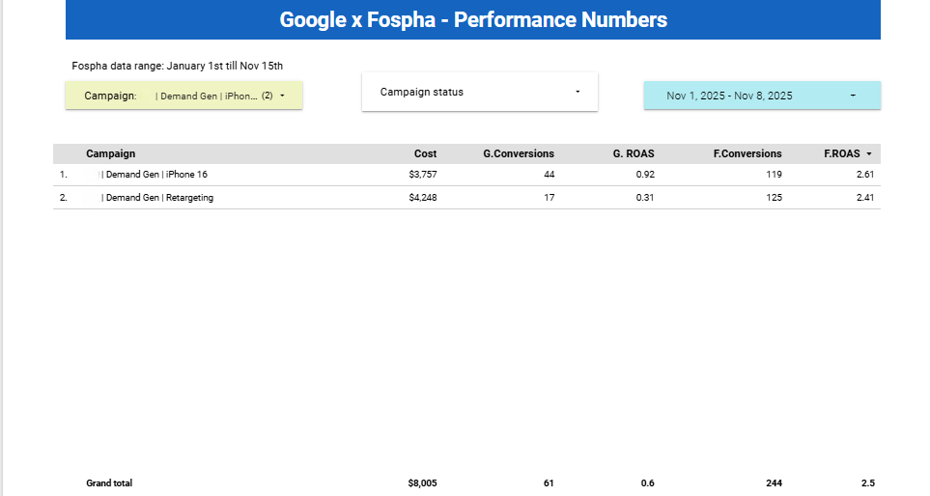
Google vs Fospha

Slide 7
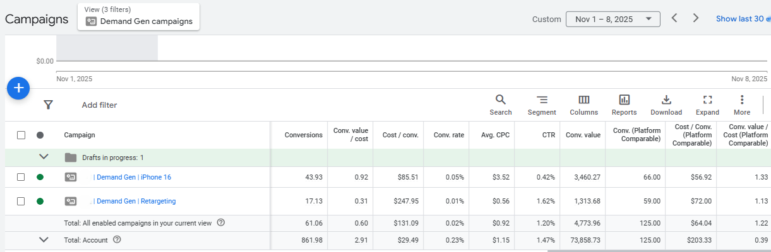
Platform comparable numbers

Slide 8
Sources
Google Ads Help: https://support.google.com/google-ads/answer/13695777
Google Ads Help; Use product feeds with Demand Gen campaigns. Retrieved from https://support.google.com/google-ads/answer/13721750?hl=en
Seer Interactive: https://www.seerinteractive.com/insights/google-performance-max-vs-demand-gen
Think with Google: https://www.thinkwithgoogle.com/
Adsmurai: https://www.adsmurai.com/en/articles/google-demand-generation-campaigns
Blueprint Digital: https://blueprintdigital.com/blog/demand-gen-vs-performance-max/
https://www.youtube.com/watch?v=iIr71xV_oms&utm
Google Marketing Live 2024 Keynote

